Slide 1
LR Parsers

Slide 2
LR Parsers
The most powerful shift-reduce parsing is:
LR(k) parsing.
Left to right scanning
Right-most derivation
k lookhead (k is omitted → it is 1)

Slide 3
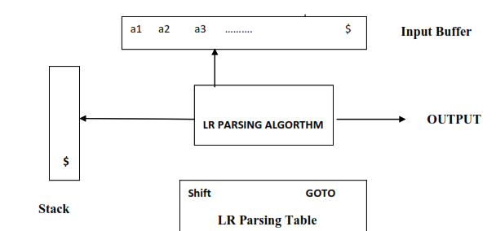
Components of LR Parsing

Slide 4
Input buffer:
It contains the string to be parsed followed by a $ Symbol.
Stack:
It containing a sequence of grammar symbols with a $ at the bottom of the stack,
Initially contains the Initial state of the parsing table on top of $.

Slide 5
Parsing table (M):
It is a two dimensional array M[ state, terminal or Non terminal] and
It contains two parts
1. ACTION Part
2D array indexed by state and the Input symbol,
i.e. ACTION[state][input].
1. Shift.
2. Reduce
3. Accept
4. Error entry.

Slide 6
2. GO TO Part
2D array indexed by state and a Non terminal,
i.e. GOTO[state][NonTerminal].
A GO TO entry has a state number in the table.

Slide 7
Classification of LR Parsers
1. LR ( 0 )
2. SLR ( 1 )
3. CLR ( 1 )
4. LALR ( 1 )

Slide 8
LR(0)
Steps are
1. Add Augment production
2. Create Canonical collection of LR ( 0 ) items
3. Construct the LR ( 0 ) Parsing table
4. Construct the Parse Table

Slide 9
Ex: Construct LR(0) parser and verify
the string “abb” is accepted or not
S → AA, A → aA | b
Sol: Given
S→AA ➔R₁
\ A→aA ➔R₂
A→b ➔R₃
Step1: Augmented Grammar
S’→S
S→AA
A→aA
A→b
:

Slide 10
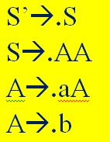
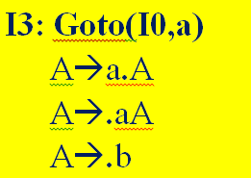

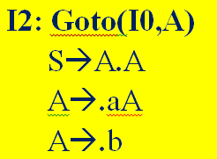

Step2: Closure(S’→S): I0

Slide 11

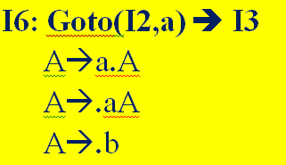


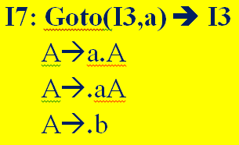


Slide 12
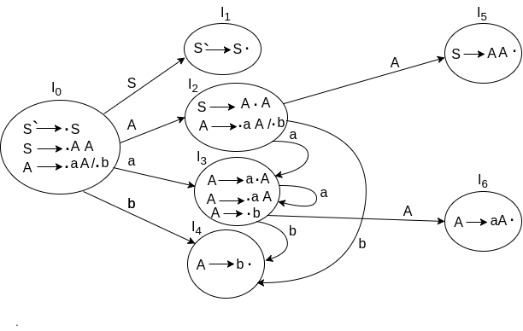
DFA

Slide 13
Step3: Parse Table Construction
Identify ended productions for Placing Reduction
I4 : A → b• →R3
I5 : S → AA• →R1
I6 : A → aA• →R2

Slide 14
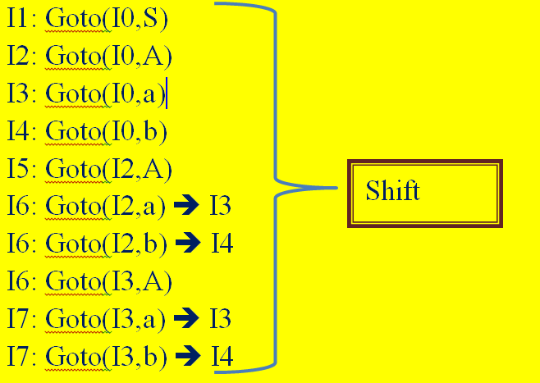
Consider Items for SHIFT action

Slide 15
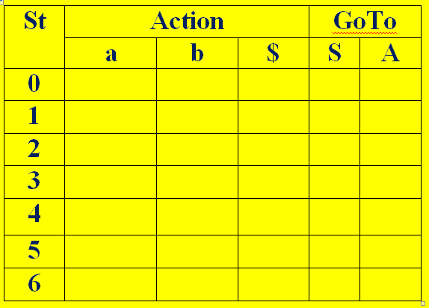
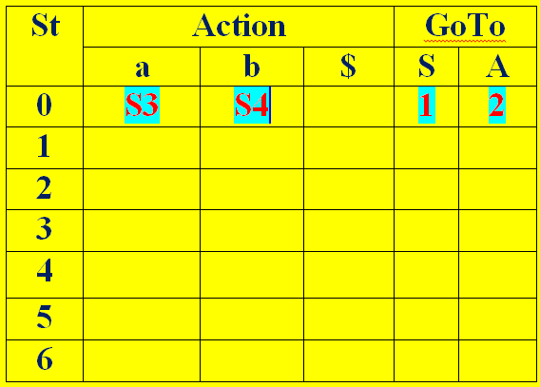
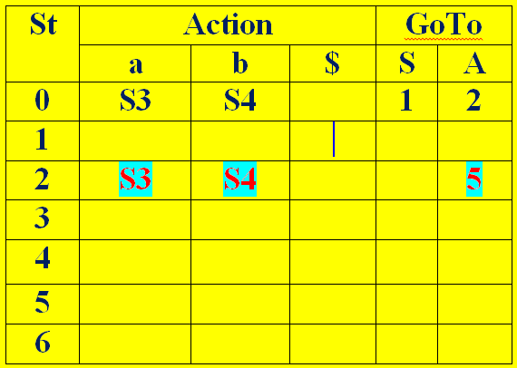
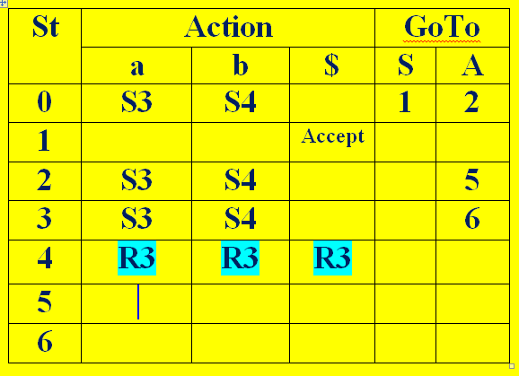
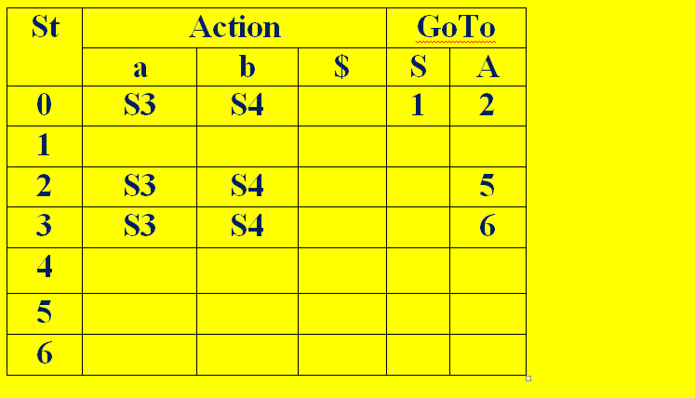
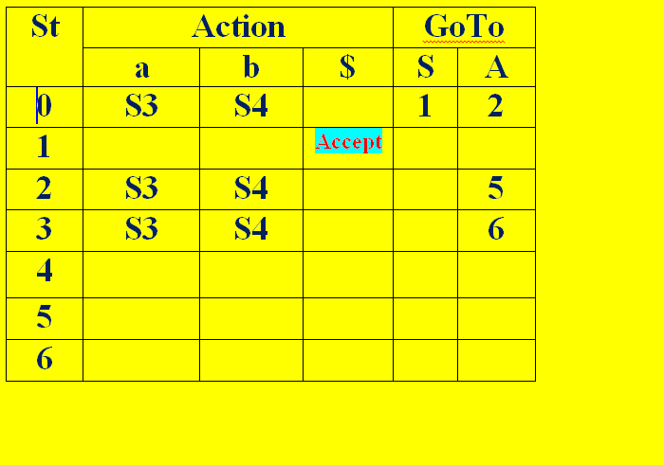
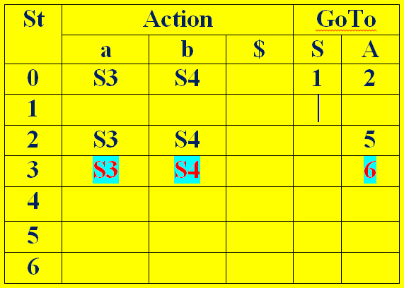
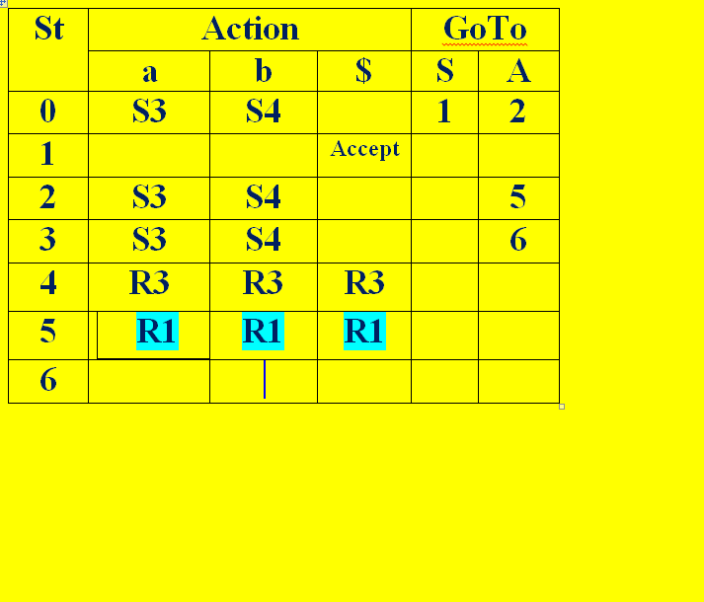
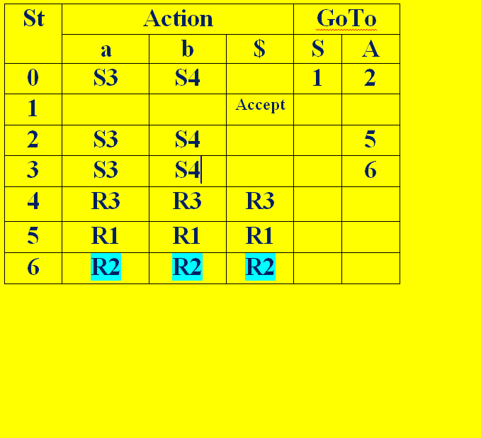
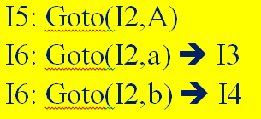
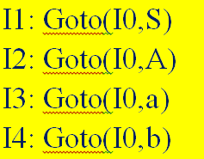
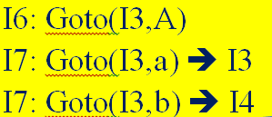
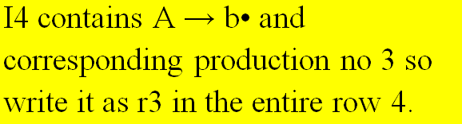
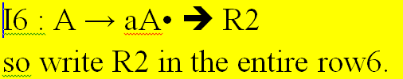
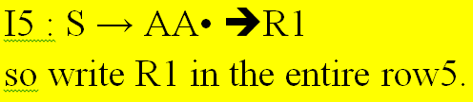

Parse Table:

Slide 16
Stack Implementation for Input string “abb”
Stack I.Buffer Action
$0 abb$ Shift
$0a3 bb$ Shift
$0a3b4 b$ A→b
$0a3A6 b$ A→aA
$0A2 b$ Shift $0A2b4 $ A→b
$0A2A5 $ S→AA
$0S1 $ Accept
LR0 | Action |  |  | GoT
 | a | b | $ | S | A
0 | S3 | S4 |  | 1 | 2
1 |  |  | Ac
2 | S3 | S4 |  |  | 5
3 | S3 | S4 |  |  | 6
4 | R3 | R3 | R3
5 | R1 | R1 | R1
6 | R2 | R2 | R2

Slide 17
SLR ( 1 )
Simple LR Parsing
Same like LR(0) parsing except in the parsing table.
Place the reduce move only in the follow of left hand side.
Use canonical collection of LR (0) items.

Slide 18
Steps for construction:
1. Add Augment production
2. Create Canonical collection of LR ( 0 ) items
3. Construct the LR ( 0 ) Parsing table
4. Construct the Parse Table

Slide 19
Ex: Construct SLR(1) parser and verify
the string “abb” is accepted or not
S → AA, A → aA | b
Sol: Given
S→AA ➔R₁
\ A→aA ➔R₂
A→b ➔R₃
Step1: Augmented Grammar
S’→S
S→AA
A→aA
A→b
:

Slide 20
Step2: Closure(S’→S): I0

Slide 22
Step3: Parse Table Construction
Find FIRST and FOLLOW:
Given S→AA
A→aA
A→b
First(S)=First(AA)= First(A)={a,b}
First(A)={a,b}
Follow(S)={$} (by case1)
Follow(A):
S→AA; A→aA

Slide 23
Follow(A):
S→AA
Compare by A→αBβ where A=S,α=A,B=A,β=ϵ
By case3:
Follow(A)=Follow(S)={$}
Compare by A→αBβ where A=S,α=ϵ,B=A,β=A
By case2:
Follow(A)=First(A)={a,b}
A→aA
here β= ϵ So by case3 Follow(A)=Follow(A)
Finally Follow(A)={a,b,$}

Slide 24
First(S)=First(AA)= First(A)={a,b}
First(A)={a,b}
Follow(S)={$}
Follow(A)={a,b,$}

Slide 25
Step3: Parse Table Construction
Identify ended productions for Placing Reduction
I4 : A → b• →R3➔{(4,a)(4,b)(4,$)}.
I5 : S → AA• →R1➔ {(5,$)}.
I6 : A → aA• →R2➔ {(6,a)(6,b)(6,$)}.

Slide 26
Consider Items for SHIFT action

Slide 27
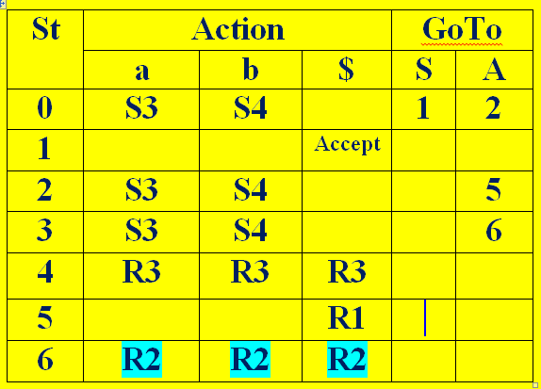
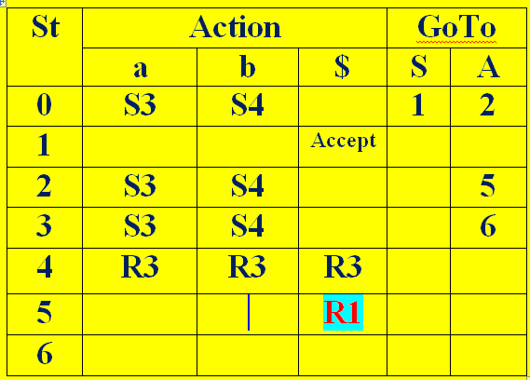
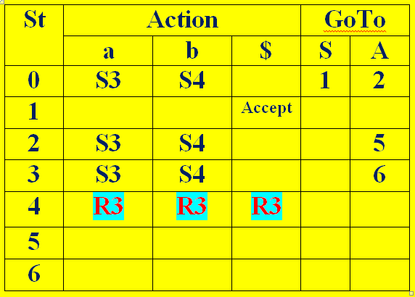
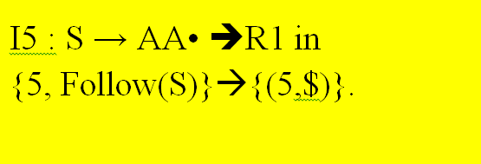
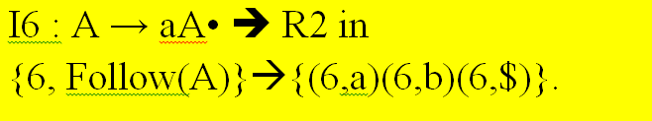
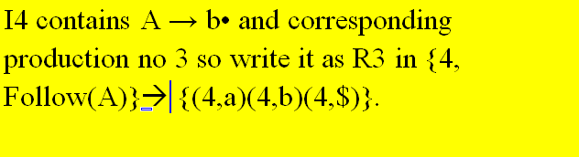
Parse Table:

Slide 28
Stack Implementation for Input string “abb”
Stack I.Buffer Action
$0 abb$ Shift
$0a3 bb$ Shift
$0a3b4 b$ A→b
$0a3A6 b$ A→aA
$0A2 b$ Shift $0A2b4 $ A→b
$0A2A5 $ S→AA
$0S1 $ Accept
SLR | Action |  |  | GoT
 | a | b | $ | S | A
0 | S3 | S4 |  | 1 | 2
1 |  |  | Accept
2 | S3 | S4 |  |  | 5
3 | S3 | S4 |  |  | 6
4 | R3 | R3 | R3
5 |  |  | R1
6 | R2 | R2 | R2

Slide 29
Canonical LR ( 1 )
Canonical lookahead Parser
LR (1) items to build
Produces the more number of states as compare to the SLR (1) parsing.
Place the reduce node only in the lookahead symbols.

Slide 30
Steps are
Add augment production in the given grammar
Create canonical collection of LR (1) items
(LR(1)=LR (0) item + look ahead)
Construct a CLR (1) parsing table

Slide 31
Construct the CLR(1) parse table for S→AA; A→aA | b.
Given
S→AA ➔R₁
A→aA ➔R₂
A→b ➔R₃
Step1: Augmented Grammar
S’→S
S→AA
A→aA
A→b

Slide 32
Step2: LR(1) Items
Always begin with augmented grammar production with $
S’→.S,$
To close match the item with A→α.xβ,a
Where α = ϵ, x = S, β=ϵ, a=$
If there is a production x→ﻹ,b then add x→. ﻹ,b
Here X=S
S→.AA ,b
b=First(βa)=First(ϵ$)=First($)={$}
i.e S→.AA ,$
Match the item with A→α.xβ,a
Where α = ϵ, x = A, β=A, a=$
If there is a production x→ﻹ,b then add x→. ﻹ,b

Slide 33
Here X=A
A→.aA,b
b=First(A$)=First(A)={a,b}
i.e A→.aA, a | b
A→.b, b
b=First(A$)=First(A)={a,b}
i.e A→.b, a | b
If the next symbol of “.”(dot) is terminal then no need of compare.

Slide 34
Finally the productions are
S’→S,$
S→AA ,$
A→aA, a | b
A→b, a | b

Slide 35
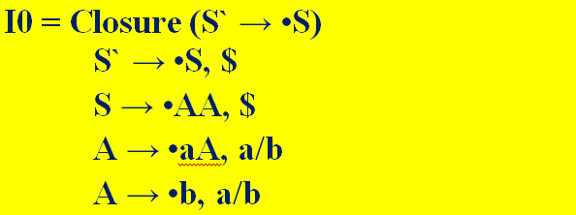

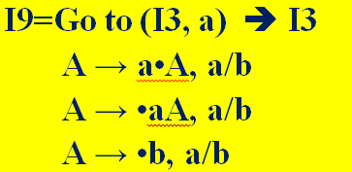
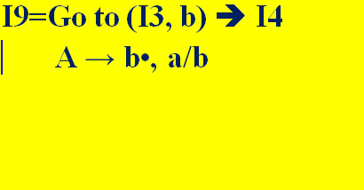
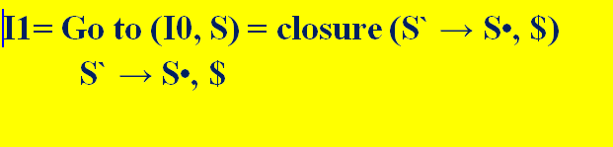
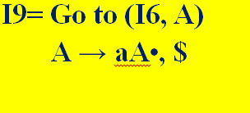
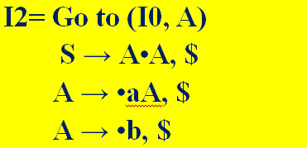
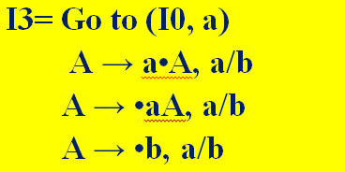
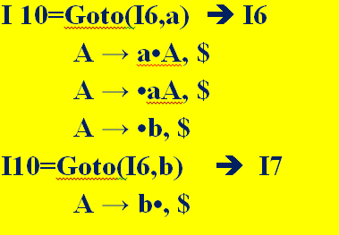
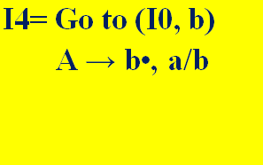

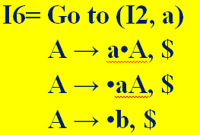
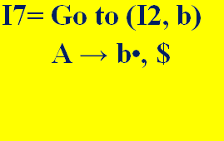

Slide 36
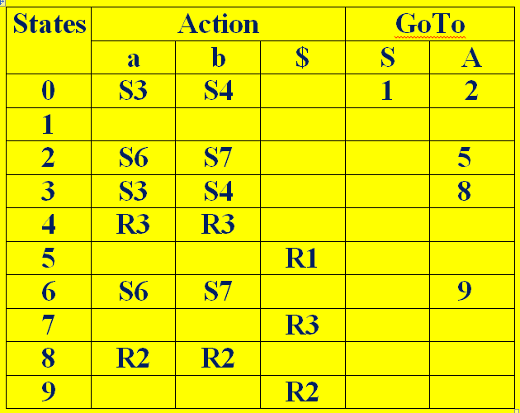
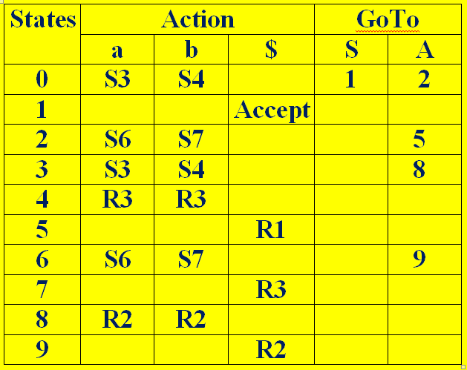
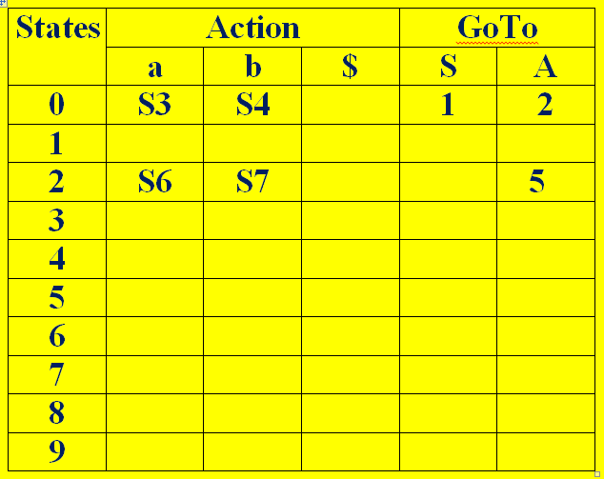
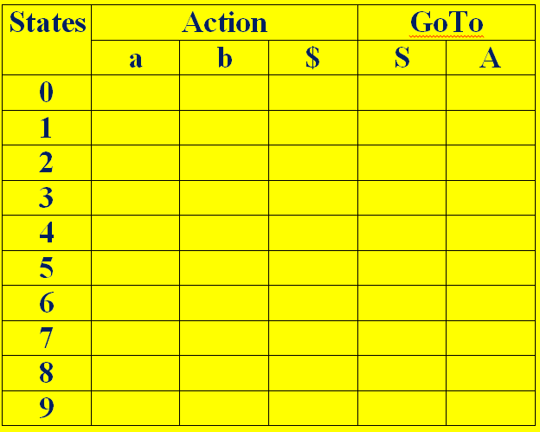
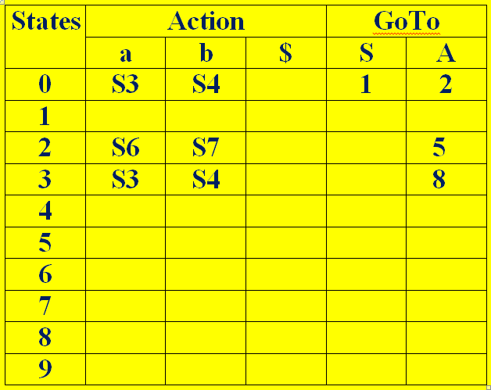
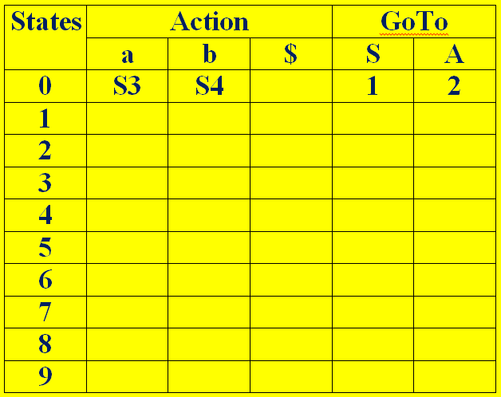
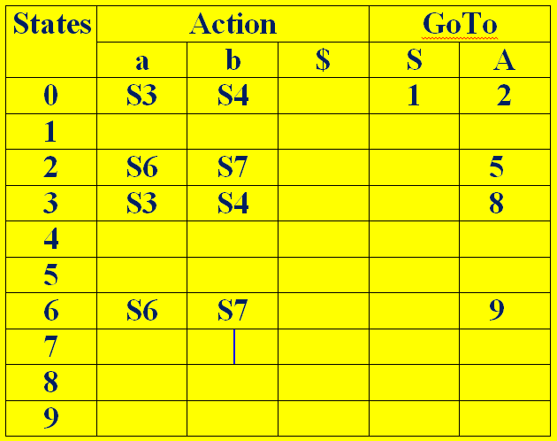
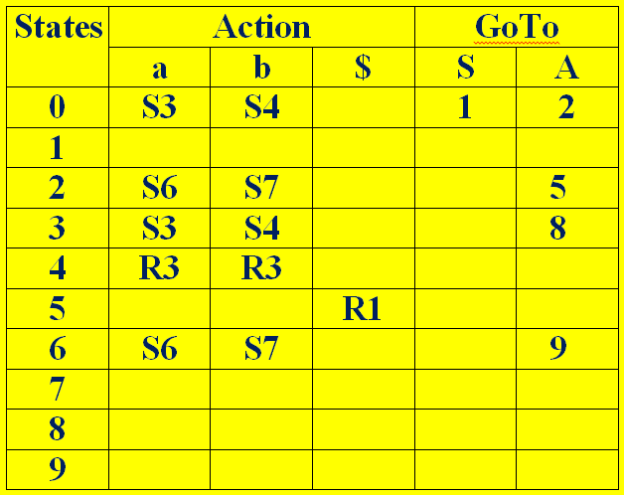
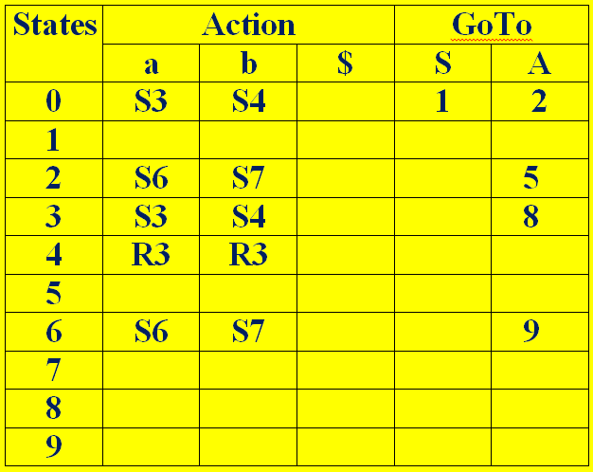
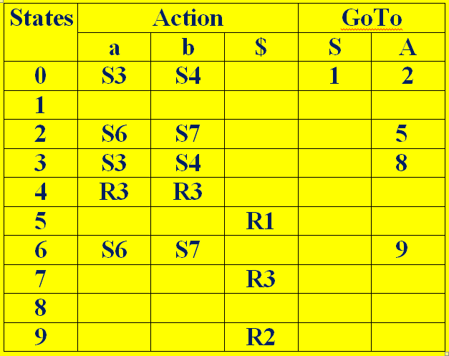











Step3: Construct a CLR (1) parsing table

Slide 37

DFA

Slide 38
Stack Implementation for Input string “abb”
Stack I.Buffer Action
$0 abb$ Shift
$0a3 bb$ Shift
$0a3b4 b$ A→b
$0a3A8 b$ A→aA
$0A2 b$ Shift $0A2b7 $ A→b
$0A2A5 $ S→AA
$0S1 $ Accept

Slide 39
LALR (1) Parsing

Slide 40
LALR(1)
LALR refers to the Look Ahead LR.
LR (1) items required to construct.
In the LALR (1) parsing, the LR (1) items which have same productions but different look ahead are combined to form a single set of items.
LALR (1) parsing is same as the CLR (1) parsing, only difference in the parsing table.

Slide 41
Steps are
Add augment production in the given grammar
Create canonical collection of LR (1) items
(LR(1)=LR (0) item + look ahead)
LR (1) items should be combine.
Construct a LALR (1) parsing table

Slide 42
Construct the LALR(1) parse table for S→AA; A→aA | b.
Given
S→AA ➔R₁
A→aA ➔R₂
A→b ➔R₃
Step1: Augmented Grammar
S’→S
S→AA
A→aA
A→b

Slide 43
Step2: LR(1) Items
Always begin with augmented grammar production with $
S’→.S,$
To close match the item with A→α.xβ,a
Where α = ϵ, x = S, β=ϵ, a=$
If there is a production x→ﻹ,b then add x→. ﻹ,b
Here X=S
S→.AA ,b
b=First(βa)=First(ϵ$)=First($)={$}
i.e S→.AA ,$
Match the item with A→α.xβ,a
Where α = ϵ, x = A, β=A, a=$
If there is a production x→ﻹ,b then add x→. ﻹ,b

Slide 44
Here X=A
A→.aA,b
b=First(A$)=First(A)={a,b}
i.e A→.aA, a | b
A→.b, b
b=First(A$)=First(A)={a,b}
i.e A→.b, a | b
If the next symbol of “.”(dot) is terminal then no need of compare.

Slide 45
Finally the productions are
S’→S,$
S→AA ,$
A→aA, a | b
A→b, a | b

Slide 46
Step2: LR(1) Items

Slide 47



Slide 48



If we analyze then LR (0) items of I3 and I6 are same but they differ only in their lookahead.

Slide 49

DFA

Slide 50

















LALR PARSE Table:

Slide 51
Stack Implementation for Input string “abb”
St | Action |  |  | GoTo
 | a | b | $ | S | A
0 | S36 | S47 |  | 1 | 2
1 |  |  | Ac
2 | S36 | S47 |  |  | 5
36 | S36 | S47 |  |  | 89
47 | R3 | R3 | R3
5 |  |  | R1
89 | R2 | R2 | R2
Stack I.Buffer Action
$0 abb$ shift
$0a36 bb$ shift
$0a36b47 b$ A→b
$0a36A89 b$ A→aA
$0A2 b$ Shift
$0A2b47 $ A→b
$0A2A5 $ S→AA
$0S1 $ Accept

Slide 52


Slide 53
YACC
YACC stands for Yet Another Compiler Compiler.
This program is designed to compile a LALR(1).
The input of YACC is the rule or grammar and the output is a C program.
Input: A CFG- file.y
Output: A parser y.tab.c (yacc)

Slide 54

Representation

Slide 55
Structure of the YACC Prog
---------------------------------
Declaration Section
---------------------------------
% %
---------------------------------
Translation Rule Section
---------------------------------
% %
---------------------------------
Auxiliary Procedures Section
---------------------------------

Slide 56
Declaration Section :-
Contains the declaration for variables required
for YACC program.
Translation Rule Section :-
Contains the Rules/Grammars
Production { action 1 }
Production { action 2 }
Production { action 3 }
---------------------------------------
Production { action n }
Auxiliary Procedure Section :-
Contains all the procedures used in your C - code

Slide 57
Built-in Function
yyparse() :-
This is a standard parse routine
Used for calling syntax analyzer for given tranlation rules.
yyerror() :-
Displaying any error message.
yywrap() :-
It is used for taking i/p from more one file.

Slide 58
Built-in Types
%token:
Used to declare the tokens used in the grammar.
Eg :- %token NAME NUMBER
2) %start:
Used to declare the start symbol of the grammar.
Eg.:-%start stm
3) %left
Used to assign the associativity to operators.
Eg.:-%left '+' '-' - Assign left associativity to + & -with lowest precedence.

Slide 59
4) %right :-
Used to assign the associativity to operators.
5) %nonassoc :-
Used to unassociate.
Eg.:- %nonassoc UMINUS.
6) %prec :-
Used to tell parser use the precedence of the given code.
Eg.:- %prec UMIN
7) %type :-
Used to create the type of a variable.
Eg.:- %type <name of any variable>exp

Slide 60
Executing YACC programs follow the following steps-
1) Compile *.y file with yacc
# yacc –d *.y
It will generate y.tab.c and y.tab.h files.
2) Compile *.l file with lex command
# lex *.l
It will generate lex.yy.c file for your lexical
analyzer.

Slide 61
3) Compile and link lex.yy.c and y.tab.c file with cc command
# cc lex.yy.c y.tab.c
4) Execute the *.out file to see the output
# ./a.out

Slide 62
Thank You
Thank You

Slide 63
lex Proram:
//Calculator by using YACC
%{
#include <stdio.h>
#include "y.tab.h"
Int c;
extern int yylval;
%}
%%
" " ;

Slide 64
[ a-z] { c = yytext[0];
yylval = c - 'a';
return(LETTER); }
[0-9] { c = yytext[0];
yylval = c - '0';
return(DIGIT); }
[^a-z0-9\b] { c = yytext[0];
return(c); }

Slide 65
YACC program::
//Calculator by using YACC
%{
#include <stdio.h>
int regs[26]; int base;
%}
%start list
%token DIGIT LETTER

Slide 66
%left '|'
%left '&'
%left '+' '-'
%left '*' '/' '%'
%left UMINUS
%%

Slide 67
%% /* beginning of rules section */
list: /*empty */
|
list stat '\n'
|
list error '\n'
{
yyerror();
}
;

Slide 68
stat: expr
{
printf("%d\n",$1);
}
|
LETTER '=' expr
{
regs[$1] = $3;
}
;

Slide 69
expr: '(' expr ')'
{
$$ = $2;
}
|
expr '*' expr
{
$$ = $1 * $3;
}
|
expr '/' expr
{
$$ = $1 / $3;
}

Slide 70
| expr '%' expr
{
$$ = $1 % $3;
}
| expr '+' expr
{
$$ = $1 + $3;
}
|

Slide 71
number: DIGIT
{
$$ = $1;
base = ($1==0) ? 8 : 10;
} |
number DIGIT
{
$$ = base * $1 + $2;
}
;

Slide 72
expr '-' expr
{
$$ = $1 - $3;
}
|
LETTER
{
$$ = regs[$1];
}
|
number
;

Slide 73
%%
main()
{ return(yyparse()); }
yyerror(s)
char *s;
{
fprintf(stderr, "%s\n",s); }
ywrap()
{ return(1); }

Slide 74
student@localhost ~]$ gedit program3y.y
[student@localhost ~]$ yacc -d program3y.y
[student@localhost ~]$ lex program3l.l
[student@localhost ~]$ gcc lex.yy.c y.tab.c
[student@localhost ~]$ ./a.out
3+4
7
7*9
63

